Slide 1


Project 2: Customer Behavior Analysis
Performed by Ansh Ranjan & Sarvesh Sharma

Slide 2
Target
To Analyze customer behavior and calculate Customer Retention Rates and Churn Rates
Steps:
Ingestion: Use ADF to ingest raw data into the Bronze layer.
Transformation: Use Databricks to group interactions by session and clean invalid entries, storing the result in the Silver layer.
Analysis: Compute customer retention and churn rates in the Gold layer.
Predictive Model: Use Databricks for logistic regression to predict likelihood of a customer to be single time or returning customer
For a detailed walkthrough of the project, please refer to the project explanation video. https://youtu.be/bea1e6fx1uo

Slide 3
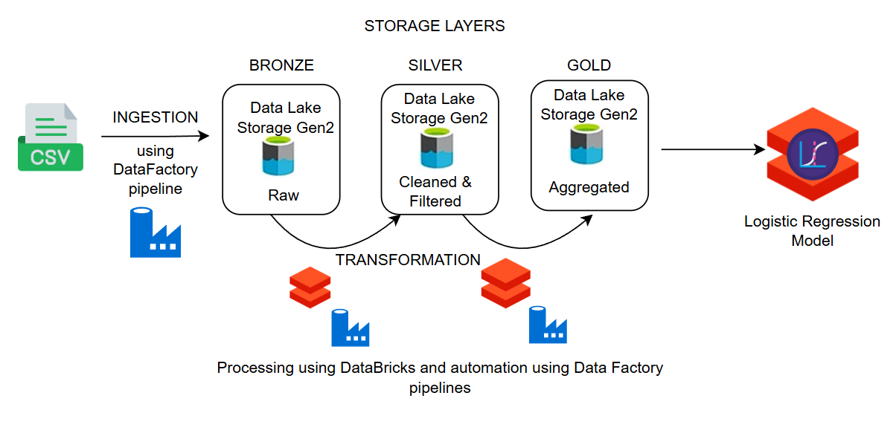
Architecture

Slide 4
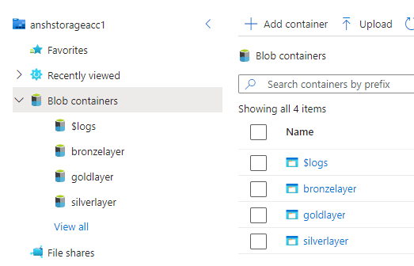
Storage
Create a storage account with 4 containers
Rawdata : Raw data of outside source
Bronzelayer : Ingested raw data
Silverlayer : Cleaned, filtered and transformed data
Goldlayer : Data to use business logic on

Slide 5
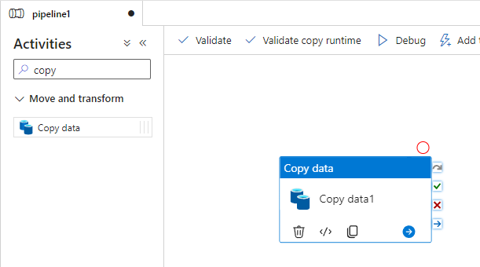
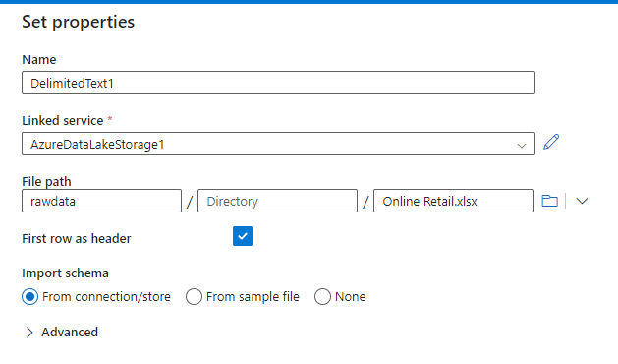
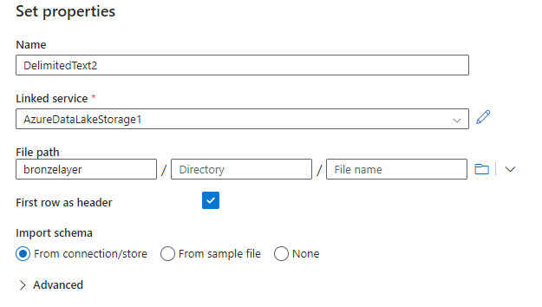
Ingestion – Bronze Layer
Create a DataFactory pipeline to read data from source (rawdata container) and ingest it into our Bronze Layer
Select the source and sink
Validate, Publish and Trigger the pipeline
Activity Source Sink

Slide 6

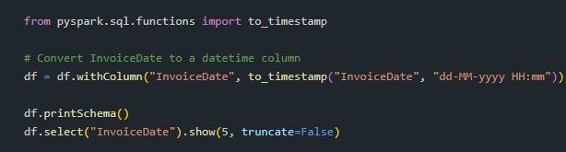
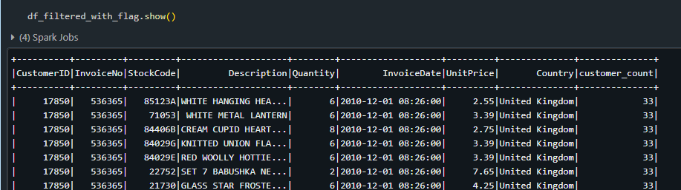
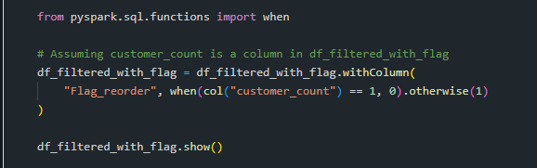
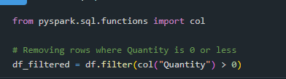
Cleaning – Silver Layer
Load Data from bronzelayer container
Drop Null values
Drop Duplicated
Filter invalid data
Create a column for number of purchases for each customer
Create a Flag column for customer being one time or regular customer
Load the data in silverlayer container

Slide 7
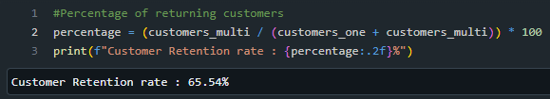

Gold Layer
Aggregate the data by InvoiceNo
Aggregate the data by CustomerID
Calculate the Retention Rate
As
Churn Rate
As

Slide 8
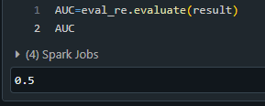
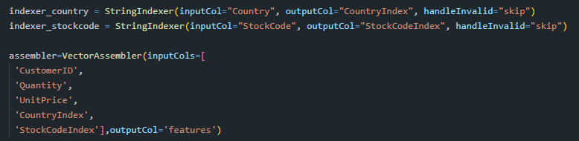
Logistic Regression
Creating a logistic regression model to predict if a customer will be returning customer or a one time customer only
Dropping unnecessary columns
Indexing string columns (Country Name and StockCode)
Vectorizing the columns as features
Creating a LogisticRegression function
Creating a pipeline to ensure sequential and serial execution
Split dataset into train and test
Train the model and test it to get accuracy

Slide 9
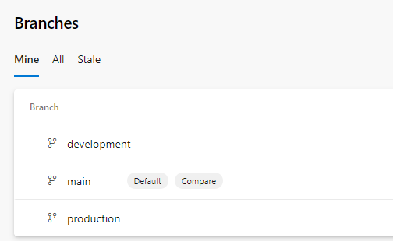
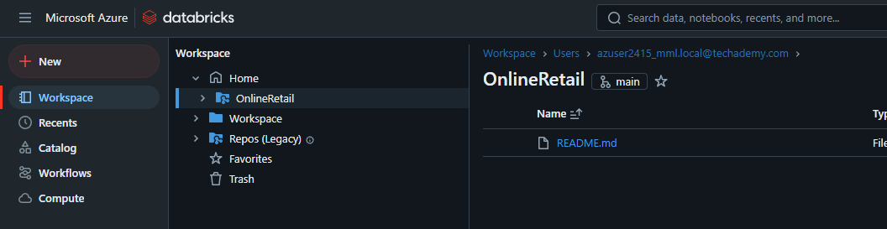
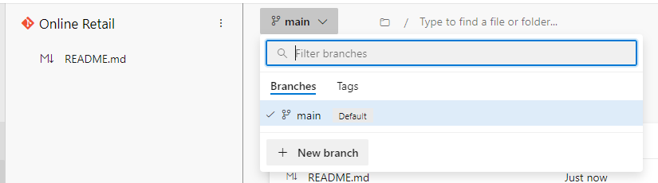
Azure Git Repo
Create a Azure Git Repo
Create 3 branches :
Main : the main branch
Development : Where we write and push code
Production : The live branch where notebooks execute
Clone the repo to your Azure Databricks workspace

Slide 10
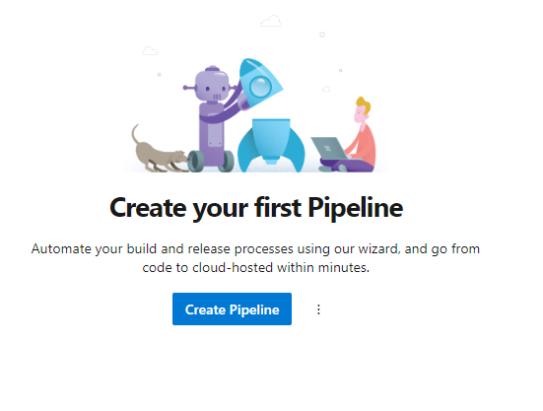
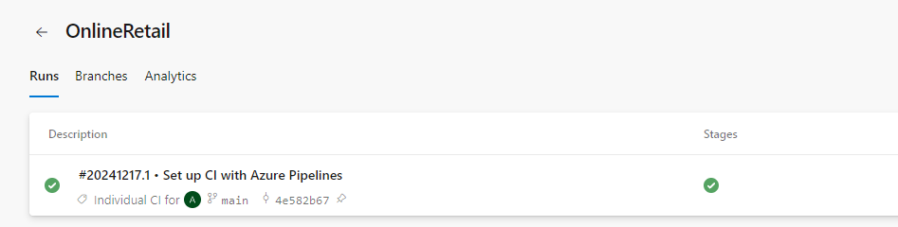
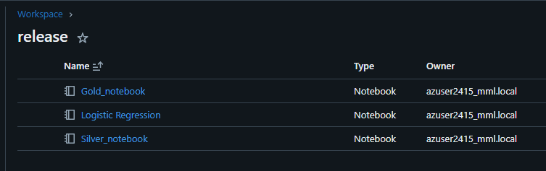
CI/CD pipeline
Create a CI/CD pipeline to perform 2 functionalities
1st Functionality:
Detect when there are changes in main branch
Automatically pull and merge the changes to production branch
2nd Functionality:
Detect when there are changes in main branch
Auto deliver the latest artifacts from main branch to a folder in our databricks workspace

Slide 11
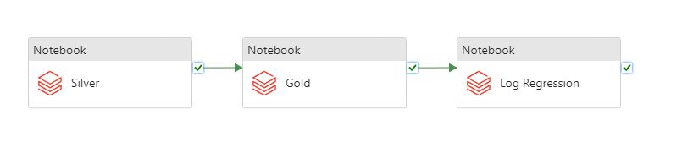
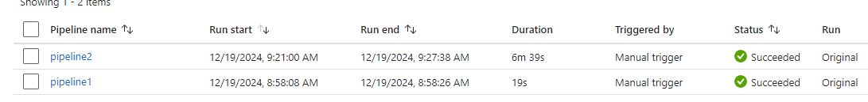
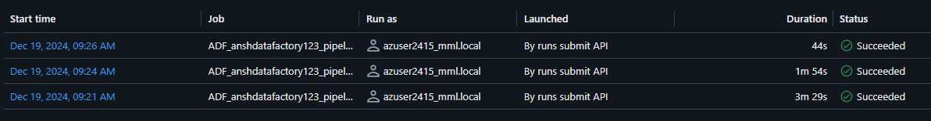
Azure DataFactory Pipeline
The notebooks we created do not need to be run manually
We can automate the execution of the notebook by using Azure DataFactory
- Create a pipeline - Grab 3 notebook activity blocks, one for silver, gold and Log Reg each - Link them by ‘on-success’ condition - Validate and Publish the pipeline - Trigger the execution - check the output in Job Run tab of databrick workspace

Slide 12
Results
The dataset contains Invoice and sales data in a period of 1 year of a store
In the Gold Layer we have calculated that the across this time period of 1 year
The store’s customer retention rate is 65.54%
And churn rate is 34.46%
Furthermore the Logistic Regression model we created had an accuracy of 50%

Slide 13
Conclusion
The project provides a scalable and efficient ETL workflow for customer behavior analysis using the Medallion architecture (Bronze, Silver, Gold layers).
Key business insights, such as customer purchase trends and churn likelihood, empower data-driven decision-making for improving customer retention.
The use of Azure Data Factory and Databricks ensures seamless orchestration and powerful transformations, enabling efficient data processing and predictive analytics.
By incorporating CI/CD pipelines, the workflow achieves operational reliability and streamlined deployment across environments.
The methodology can be extended to similar retail datasets, offering a robust framework for customer analytics in other industries.

Slide 14

Thank You

